Slide 2
2 TIMOTHY 4:6-8
James 4:14

Slide 3
“What if this is my last sermon?”
Acts 20:17-38

Slide 4
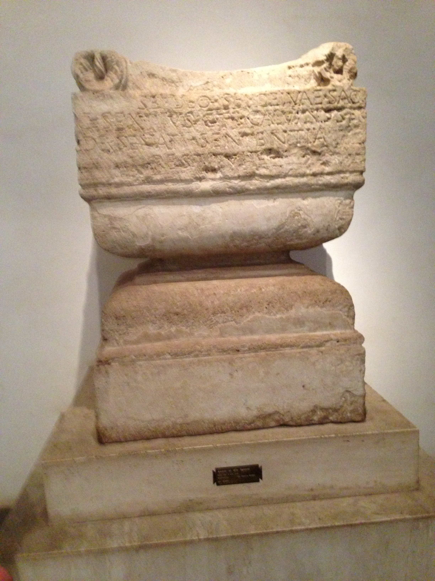
Declare the whole counsel of god
Acts 20:26,27 – Never held anything back that was needed
What did Paul preach on Mars Hill in Athens?
Some “neutral” subject that wouldn’t offend idolaters? NO!
Acts 17:23 – He hit the nail on the HEAD!

Slide 5
Show them the importance of humility
Acts 20:19 – Placing the good of others above my own
Philippians 2:3-8 “in lowliness of mind let each esteem others better than himself”
Deep compassion for all ensnared in sin
Those who continue to face temptations of this life

Slide 6
Urge people to be on their guard!
Acts 20:31 – Satan ever trying to get more followers
1 Peter 5:8,9 “the devil walks about like a roaring lion, seeking whom he may devour. “
Philippians 3:2 “Beware of dogs, beware of evil workers, beware of the mutilation.”
Colossians 2:8 “Beware lest anyone cheat you”
2 Peter 3:17 “being led away with the error of the wicked.”

Slide 7
Admonish elders to watch out for the flock of god
Acts 20:28 – Watch out for the flock “overseers”
Ezekiel 3:17-21 “I have made you a watchman…”
Elders must “sound warning”
Matthew 7:15 “Beware of false prophets, who come to you in sheep’s clothing, but inwardly they are ravenous wolves.”
Matthew 10:16 “I send you out as sheep in the midst of wolves…”

Slide 8
Warn that there may be apostates who will come from the elders
Acts 20:30 – “from among yourselves men will rise up, speaking perverse things, to draw away the disciples after themselves.”
Even from among the Apostles – Galatians 2:11-14 “Peter had come to Antioch, I withstood him to his face, because he was to be blamed”
Paul commanded Corinth to purge out such destructive influences – 1 Corinthians 5:6,7

Slide 9
I could not be influenced to compromise
Acts 20:22-24 – “none of these things move me; nor do I count my life dear to myself.”
Hebrews 10:38,39 “we are not of those who draw back to perdition”
Matthew 10:28 “And do not fear those who kill the body but cannot kill the soul. But rather fear Him who is able to destroy both soul and body in hell.”

Slide 10
Paul was going “bound in the spirit”
Acts 20:22 – he was under compulsion to preach the gospel
1 Corinthians 9:16 “woe is me if I do not preach the gospel.”
“Don’t preach the gospel unless you just can’t help yourself!”
Be willing to stand for the TRUTH at ANY COST!

Slide 11
Preaching the gospel to all who need it is vitally important
Acts 20:20,21 – “testifying to Jews, and also to Greeks, repentance toward God and faith toward our Lord Jesus Christ.”
Romans 1:16,17 “it is the power of God to salvation for everyone who believes,”
James 1:21 “receive with meekness the implanted word, which is able to save your souls.”

Slide 12
Seeing my own life as being of no account
Acts 20:24 – “nor do I count my life dear to myself”
Philippians 3:7-11 “I also count all things loss for the excellence of the knowledge of Christ Jesus my Lord, for whom I have suffered the loss of all things, and count them as rubbish, that I may gain Christ …and the fellowship of His sufferings, being conformed to His death,11 if, by any means, I may attain to the resurrection from the dead.,”

Slide 13
Remind brethren to “help the weak”
Acts 20:35 – “I have shown you in every way, by laboring like this, that you must support the weak. ”
1 Timothy 6:17-19 “not to be haughty, nor to trust in uncertain riches” “do good, that they be rich in good works, ready to give, willing to share, 19 storing up for themselves a good foundation for the time to come, that they may lay hold on eternal life.”

Slide 14
“free from the blood of all men”
Acts 20:26 – “Therefore I testify to you this day that I am innocent of the blood of all men.”
Acts 18:6 “But when they opposed him and blasphemed, he shook his garments and said to them, “Your blood be upon your own heads; I am clean. From now on I will go to the Gentiles.”

Slide 15
“YOU SHALL SEE MY FACE NO MORE”
Acts 20:25 – “you all, among whom I have gone preaching the kingdom of God, will see my face no more..”
Acts 20:37 all weep “..freely, and fall on Paul’s neck and kiss him..”
2 Corinthians 6:2 “In an acceptable time I have heard you, And in the day of salvation I have helped you.” Behold, now is the accepted time; behold, now is the day of salvation.”

Slide 16
“I COMMEND YOU TO GOD AND TO THE WORD OF HIS GRACE, which is able to build you up and give you an inheritance among all those who are sanctified”
Acts 20:32 – My Last Sermon Would Be My Final Opportunity To Say And Do What I Can To Save As Many Souls As Possible
Every Sermon Must Be Treated As If It Were Their LAST!
More Urgent, Thoughtful Preaching Designed to Shake Men From Their Lethargy, And Bring Lost Souls To Christ!

